Slide 1


B V RAJU INSTITUTE OF TECHNOLOGY
(UGC Autonomous) Vishnupur, Narsapur,Medak District
Department of Computer Science and Engineering
Minor Project – Final Review
Title :Driver Fatigueness Detection Using a Hybrid CNN-LSTM Approach with
D-Lib Based Facial Analysis
By:
Guided By:
Mrs. G. Ramani
Assistant Professor
BV Raju Institute of Technology
23211A05D0: K. Kalyan Yadav
23211A05F4: K. Tejas Kumar
23211A05F9: K. Manoj Kumar
23211A05G2: L. Vishnu Nayak

Slide 2
Outline
Abstract
Introduction
Literature Survey
Existing System
Problem Statement & Objectives
Proposed Modules
Proposed Architecture diagram
Algorithm Explanations
Data Flow diagram
UML Diagrams
Results & Discussion
Conclusion & future Enhancement
References
Date: 26/04/2025
© BVRIT CSE

Slide 3
Abstract
Driver fatigue significantly impairs reaction times and vehicle control, making it a critical factor in the occurrence and severity of traffic accidents. In order to increase accuracy and responsiveness, this study proposes a real-time driver fatigue detection system that combines facial landmark analysis with physiological signals .The system detects signs of stress, strain, and weariness by analyzing physiological data using a CNN-LSTM model. At the same time, a D-lib-based facial landmark detection algorithm analyzes the driver’s head posture, eye closure, and yawning to determine how sleepy they are. A four-state classification (00, 01, 10, 11) is created by integrating the binary outputs from both models (0 = normal, 1 = tired/drowsy).To avert any collisions, the system uses this combination to assess the driver’s level of weariness and instantly (within three to five seconds) activate an alert system. Compared to single-sensor techniques, our multi-modal approach greatly improves accuracy, guaranteeing prompt intervention and lowering the chance of accidents. The device provides a workable way to increase road safety and may be installed in both personal and commercial cars.
Date:26/04/2025
© BVRIT CSE

Slide 4
Introduction
Driver Drowsiness as a Major Risk Fatigue is a leading cause of serious traffic accidents worldwide due to its negative effect on a driver’s cognitive and physical abilities. Impact on Driver Performance Weariness significantly impairs reaction time, decision-making, and alertness, increasing the risk of collisions. Need for Early and Accurate Detection Current systems fail to detect early signs of drowsiness in real time, highlighting the need for a more responsive and precise solution. So we came with an hybrid CNN +LSTM model and D-LIB with which we can increase the accuracy and the driver will get the alarm like an beep sound within 3 seconds with which the driver can take precautions to avoid any accidents.
Date:26/04/2025
© BVRIT CSE

Slide 5

Literature Survey
Year | Author Name | Paper Title | Research Design | Conceptual / Theoretical framework | Major theme in paper | Future Idea
2025 | Tahesin Samira Delwar, Mangal Singh, Sayak Mukhopadhyay, Akshay Kumar | AI- and Deep Learning-Powered Driver Drowsiness Detection Method Using Facial Analysis | Experimental research with model training and evaluation | Focused on facial features (eyes and mouth) as primary indicators of drowsiness, | Road safety, real-time drowsiness detection, performance comparison of AI models | Improve detection under poor lighting and eyeglass interference.
2024 | Bandi Manideep, Hema Manogna, Narlagiri Aditya | Driver Drowsiness Detection System | Integrated CNNs and multimodal inputs including video, physiological, and facial data. | CNN-based system analyzing facial expressions, eye movement, head pose, heart rate, and skin conductance for real-time detection. | Multimodal deep learning, real-time fatigue detection, customizable alert mechanisms. | Add new features and algorithms, increase scalability, adapt to broader environments

Slide 6
Literature Survey
Year | Author Name | Paper Title | Research Design | Conceptual / Theoretical framework | Major theme in paper | Future Idea
2024 | Wanning Li | Driver Fatigue Detection Method Based on Facial Features Using Deep Learning | Literature review and comparative analysis of existing deep learning methods using facial features. | Focus on deep learning models for facial analysis; highlights CNNs, RNNs, LSTMs, and feature fusion for detecting drowsiness. | Facial-based fatigue detection, model comparison (accuracy, F1-score), | Enhance datasets for real-world variability, improve real-time performance for embedded systems.
2024 | Amina Turki, Sirine Ammar, Mohamed Karray, Mohamed Ksantini | Facial Expression-Based Drowsiness Detection System for Driver Safety Using Deep Learning Techniques | Utilizes pre-trained CNNs (VGG19 and ResNet50) with transfer learning to detect drowsiness . | Captures video, detects facial landmarks (D-Lib), computes Eye Closure Ratio (ECR) and Mouth Opening Ratio (MOR), and classifies the driver’s state (drowsy or alert). | Preventing driver drowsiness with real-time monitoring and ensemble methods. | Incorporation into Advanced Driver Assistance Systems (ADAS), handling environmental challenges like lighting variations.

Slide 7
Literature Survey
Year | Author Name | Paper Title | Research Design | Conceptual / Theoretical framework | Major theme in paper | Future Idea
2023 | Furkat Safarov, Farkhod Akhmedov, Akmalbek Bobomirzaevich Abdusalomov, Rashid Nasimov, Young Im Cho | Real-Time Deep Learning-Based Drowsiness Detection: Leveraging Computer-Vision and Eye-Blink Analyses for Enhanced Road Safety | Employs computer vision and custom datasets to analyze eye-blink and yawning patterns using facial landmarks for real-time drowsiness detection. | Combines eye-tracking, facial landmarks, and custom datasets to classify driver drowsiness in real time. | Eye-blink analysis, yawning detection, and machine learning for enhanced road safety. | Development of more sophisticated detection algorithms and deployment in real-world vehicles.
2025 | Anwar Jarndal, Hissam Tawfik, Ali I. Siam, Imad Alsyouf, Ali Cheaitou | A Real-Time Vision Transformers-Based System for Enhanced Driver Drowsiness Detection and Vehicle Safety | Utilizes Vision Transformers (ViTs) to analyze entire facial images, achieving high accuracy under challenging conditions like sunglasses or varied lighting. | Detects and classifies the driver’s state using full facial analysis and ViT models, providing robust drowsiness detection. | Vision Transformer applications in safety, non-intrusive real-time monitoring, and high accuracy in diverse scenarios. | Expanding capabilities for broader integration into vehicular systems and addressing additional challenging scenarios.

Slide 8
Existing system
Vehicle-based: Monitors the vehicle's speed, steering wheel movement, accelerator brake pattern, and lane position. For example, a. Camera mounted on the front of the vehicle tracks the lane position to identify drowsiness.
Behavior-based: Monitors visual cues like eye blinking, yawning, head bending, and closing of the eyes. A camera can take images and send them to an algorithm to identify these features.
Physiological-based: Monitors physiological Signal like brain activity, heart rate, skin Conductance, muscle activity, and head movements. This methods is intrusive because sensors are directly connected to the driver.

Slide 9
Problem Statement & Objectives
Problem Statement
Driver fatigue, characterized by slowed reaction times and reduced control, is a significant contributor to traffic accidents, often leading to severe consequences. .Current fatigue detection systems often rely on single-sensor techniques, which may lack accuracy and responsiveness, failing to provide timely intervention.A prompt, real-time alert system (activated within 3-5 seconds) is required to mitigate risks by addressing driver fatigue effectively and improving road safety.
Objectives:
Developed a system to accurately detect driver fatigue and reduce accidents caused by slowed reactions and loss of control.
Addressed the limitations of single-sensor fatigue detection systems by creating a multi-modal solution that improves accuracy and ensures timely detection of driver fatigue.
Implemented a real-time alert mechanism capable of activating within 3-5 seconds of detecting fatigue to ensure prompt intervention and enhance road safety for drivers.

Slide 10
Proposed Modules ( List of Modules)
1. In-cabin Camera: Captures real-time video of the driver inside the vehicle.
2 .Frame Preprocessing :The video is extracted from the driver in mp4 format at a resolution of three frames per second.
3. Dlib Facial Landmark Detection: The face is found is using the D-lib package, they x and y coordinates
of the facial structure of the face are mapped 68 points.
4. CNN Feature Extraction : Each facial feature is detected using shape estimation techniques. The feature extraction is done by calculating blink score based on the eye aspect ratio (EAR) and Yawn score is Calculated based lips distance using coordinates detected by the d-lib library.
5. LSTM Temporal Analysis : Analyses the sequence of features over time. It detects Temporal patterns like slow blinking or gradual drowsiness using a Long Short-Term Memory (LSTM) model.

Slide 11
Proposed Modules ( List of Modules)
6. Fatigue Inference Module : Based on Feature and Temporal Analysis predicts the drivers state whether(Alert/Drowsy/Fatigue/Critically Fatigued)
7. Alert Generation : Triggers alerts (pattern beep sound) when fatigue or drowsiness is detected.

Slide 12
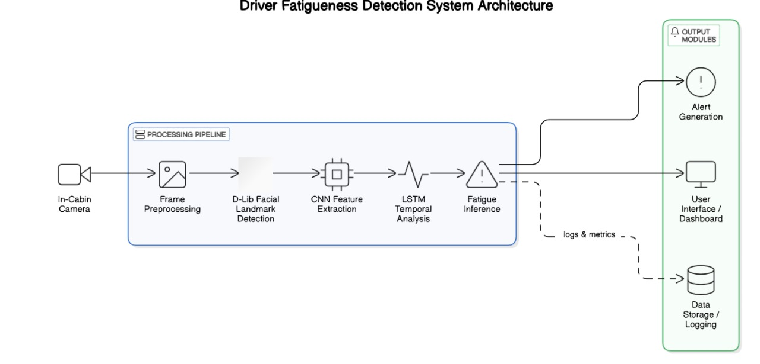
Proposed Architecture Diagram

Slide 13
Algorithm Explanation
Input:
Live video stream from camera
EEG, EMG, HRV data from sensors
Preprocessing:
a. Physiological Data:
Apply Butterworth Bandpass Filter to remove noise.
Extract features:
EEG: Theta/Alpha Ratio (TAR), Beta/Alpha Ratio (BAR)
HRV: RMSSD, SDNN, LF/HF Ratio
EMG: Root Mean Square (RMS), Zero Crossing Rate (ZCR)
Facial Data:
Use D-lib to extract 68 facial landmarks
Eye Aspect Ratio (EAR)
Mouth Opening Ratio (MOR)

Slide 14
Algorithm Explanation
CNN-LSTM for Sensor Data
CNN extracts facial features from sensor signals
LSTM captures temporal dependencies in the signal sequence
D-lib + Rule-Based Facial Analysis
Checks for:
EAR < 0.25 → Drowsy eyes
MOR > 0.5 → Yawning
vision and Classification:
Final State = Binary Combination:
00 → Normal
01 → Drowsy (face)
10 → Fatigued (sensors)
11 → Severe Fatigue (both)
If state = 01 ,10 11 trigger audio &visual alert within 3–5 seconds.

Slide 15
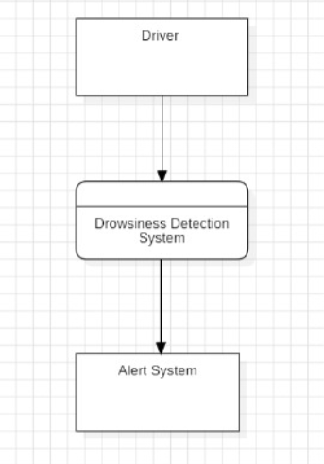
Data Flow diagram (Level 0)

Slide 16
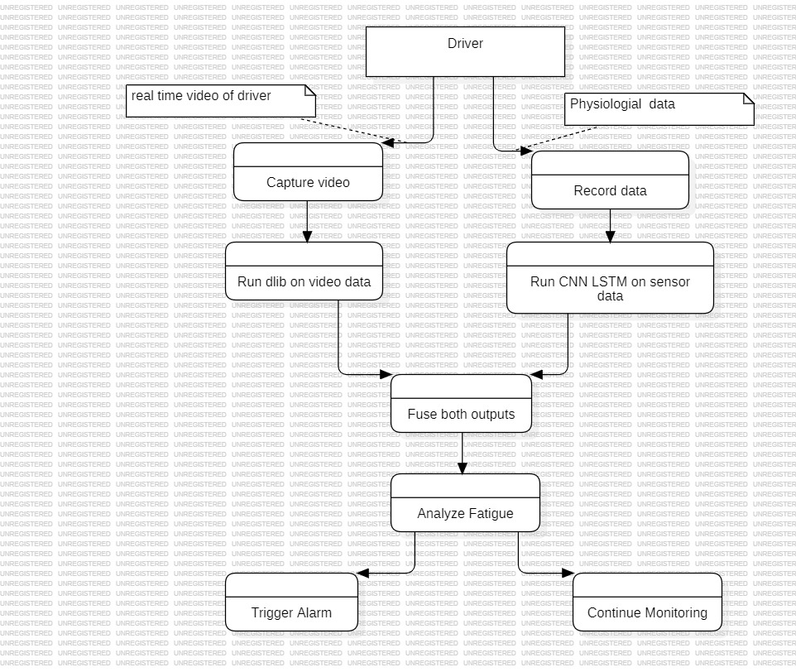
Data Flow diagram (Level 1)

Slide 17
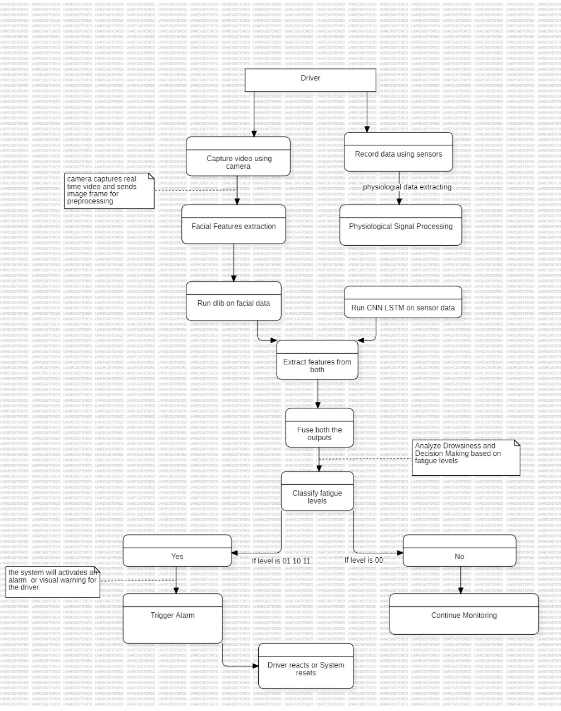
Data Flow diagram (Level 2)

Slide 18
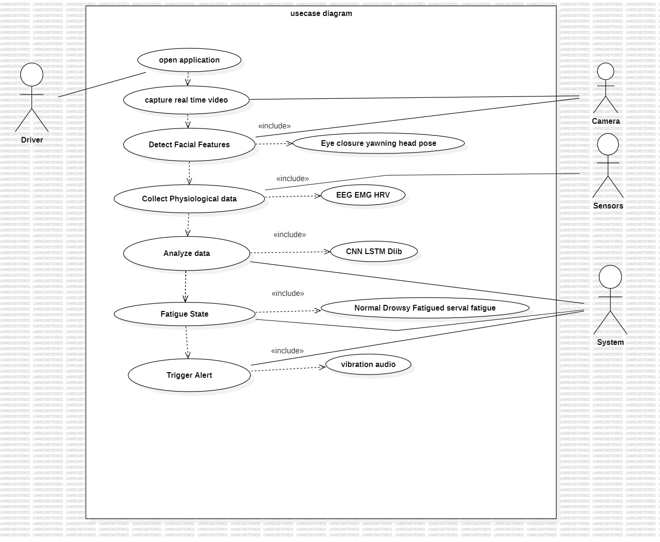
UML Diagrams – Usecase Diagram

Slide 19
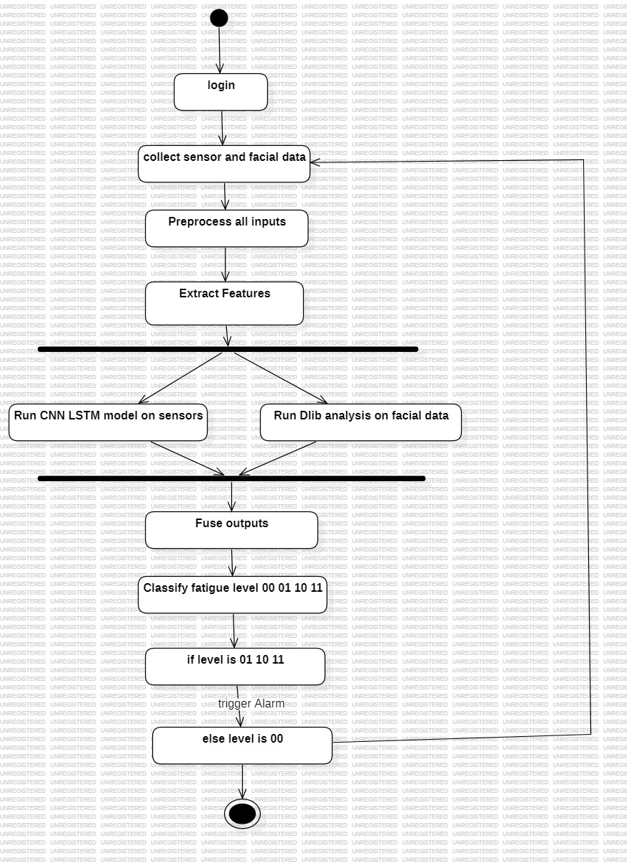
UML Diagrams – Activity Diagram

Slide 20
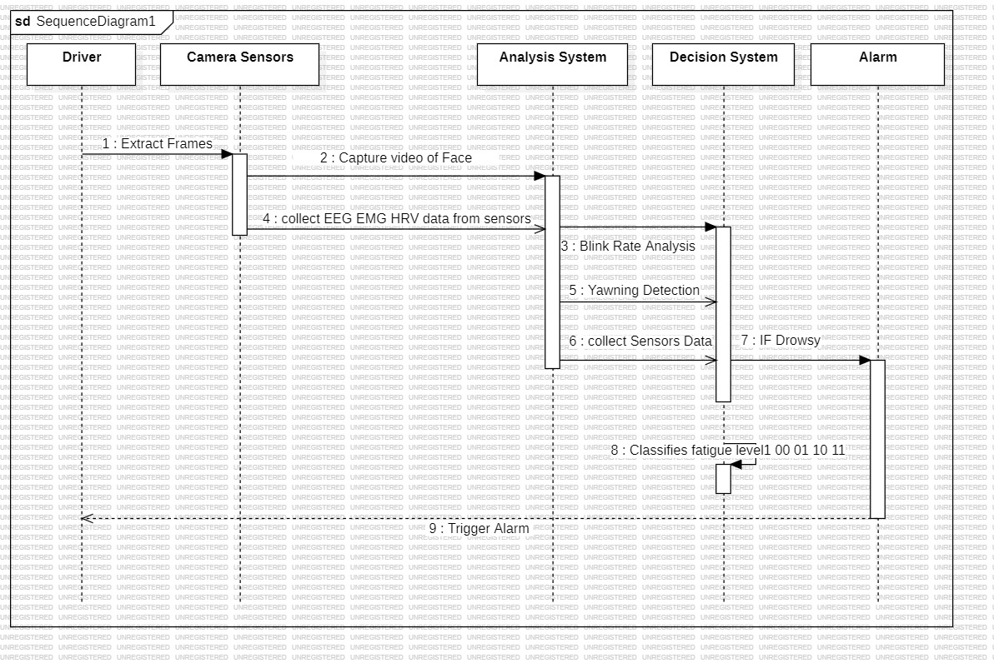
UML Diagrams – Sequence Diagram

Slide 21
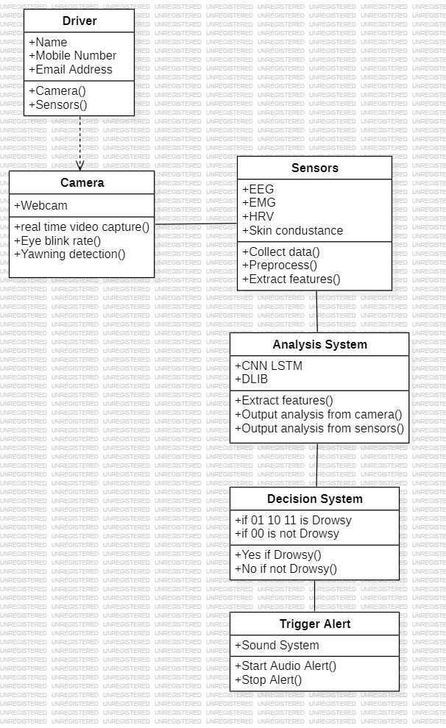
UML Diagrams – Class Diagram

Slide 22
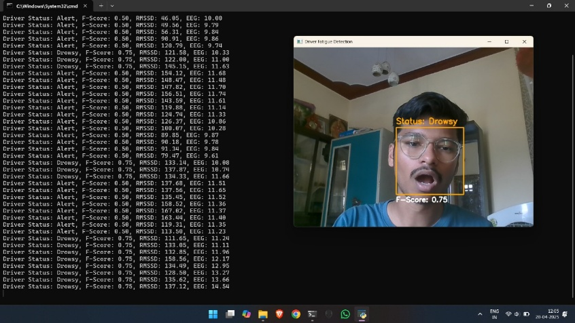
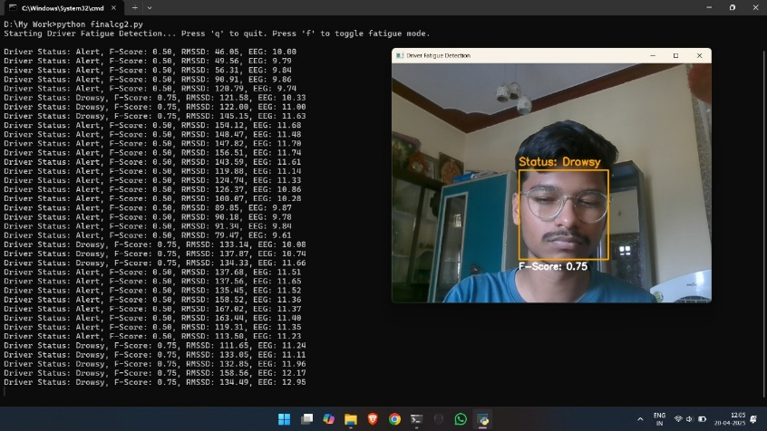
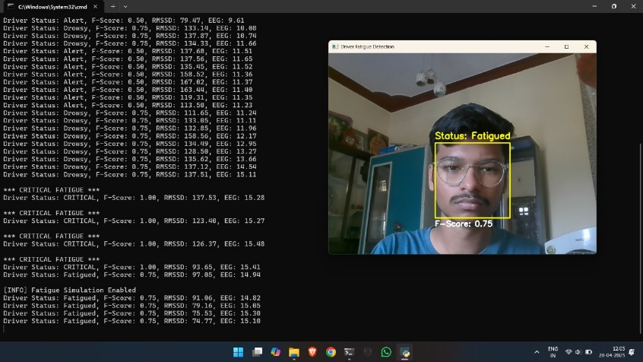
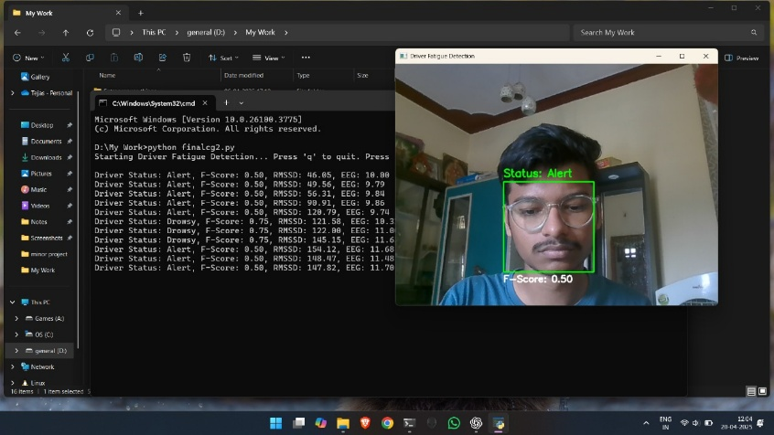
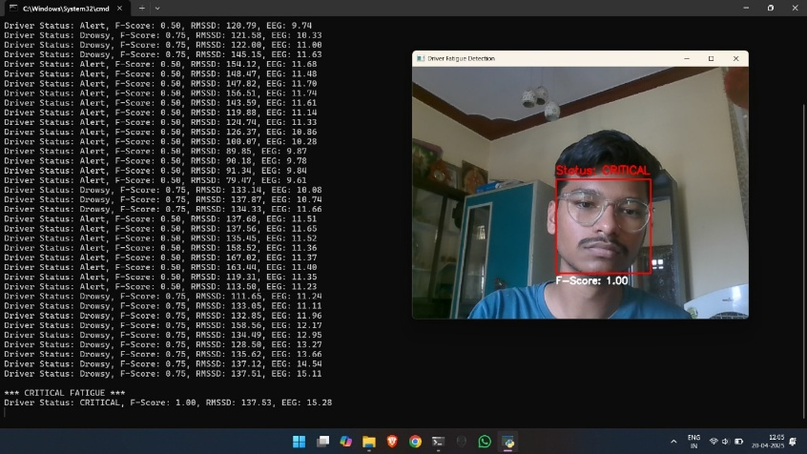
Results and Discussions
Implementation screenshots :

Slide 23
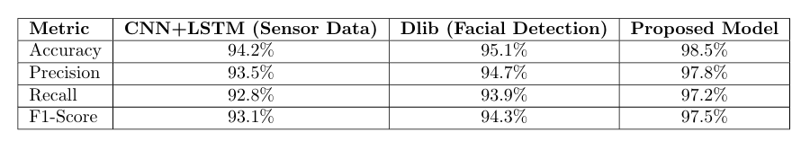
Results and Discussions
Result table & comparative table :

Slide 24
Conclusion and Future Enhancement
CONCLUSION :
Hybrid CNN-LSTM + D-lib system provides fast and accurate fatigue detection.
The proposed multi-modal fatigue detection system, combining CNN+LSTM with D-lib facial recognition, achieves high accuracy (~98%) and effectively differentiates between physical fatigue and drowsiness, enabling timely driver alerts to prevent accidents.
FUTURE ENHANCEMENT :
Expand the dataset with real-world driving data in diverse conditions (weather, lighting, traffic) to improve model robustness and accuracy.
Enable connectivity with other vehicle systems and IoT devices to trigger proactive actions like slowing the car or notifying emergency contacts.

Slide 25
References
Yuanru Guo, Kunping Yang, and Yi Wu ”A Multi-Modality Attention Network for Driver Fa tigue Detection Based on Frontal EEG, EDA, and PPG Signals” . IEEE Journal of Biomedical and Health Informatics
Sobhan Sheykhivand, Tohid Yousefi Rezaii, Zohreh Mousavi, Saeed Meshgini, Somaye Mak ouei, Ali Farzamnia, Sebelan Danishvar, and Kenneth Teo Tze Kin ”Automatic Detection of Driver Fatigue Based on EEG Signals Using a Developed Deep Neural Network” . Electronics 2022,11,2169. [CrossRef].
Ming-Zhou Liu, Xin Xu, Jing Hu, Qian-Nan Jiang ”Real-Time Detection of Driver Fatigue Based on CNN-LSTM” IET Image Processing.
Sevda Zafarmandi Ardabili, Soufia Bahmani, Lida Zare Lahijan, Nastaran Khaleghi, Sobhan Sheykhivand, Sebelan Danishvar ”A Novel Approach for Automatic Detection of Driver Fa tigue Using EEG Signals Based on Graph Convolutional Networks” Sensors 2024, 24, 364. [CrossRef] [PubMed]
Sandeep Singh Sengar, Aswin Kumar, Owen Singh Title: ”VigilEye- Artificial Intelligence based Real-time Driver Drowsiness Detection” Preprint submitted to Elsevier . [CrossRef].
Sarita Kumari, Harsha K, Kehkeshan Jallal S, Kusumika Krori Dutta, Mohammad Hashim ”Driver Drowsiness Detection Using Facial Landmarks: A Comprehensive Survey on Tech niques, Algorithms, and Applications” J. Electrical Systems 20-11s (2024): 2828-2837. [Cross Ref] [PubMed]
Varun Shiva Krishna Rupani, Velpooru Venkata Sai Thushar, Kondadi Tejith, S. Janardhana Rao ”Real-Time Drowsiness Detection Using Eye Aspect Ratio and Facial Landmark Detection” Affiliation: Institute of Aeronautical Engineering, Hyderabad, India.
Shruti Mohanty, Shruti V Hegde, Supriya Prasad, J. Manikandan ”Design of Real-time Drowsi ness Detection System using Dlib” WIECON-ECE Conference,November 2019. [Cross Ref]
Abdusalomov, A.B.; Nasimov, R.; Nasimova, N.; Muminov, B.; Whangbo, T.K. Evaluating Synthetic Medical Images Using Artificial Intelligence with the GAN Algorithm. Sensors 2023, 23, 3440. [CrossRef] 30
Safarov, F.; Kutlimuratov, A.; Abdusalomov, A.B.; Nasimov, R.; Cho, Y.-I. Deep Learning Recommendations of E-Education Based on Clustering and Sequence. Electronics 2023, 12, 809. [CrossRef]
© BVRIT CSE
15

Slide 26
Thank You ………..
© BVRIT CSE
16

